Slide 1
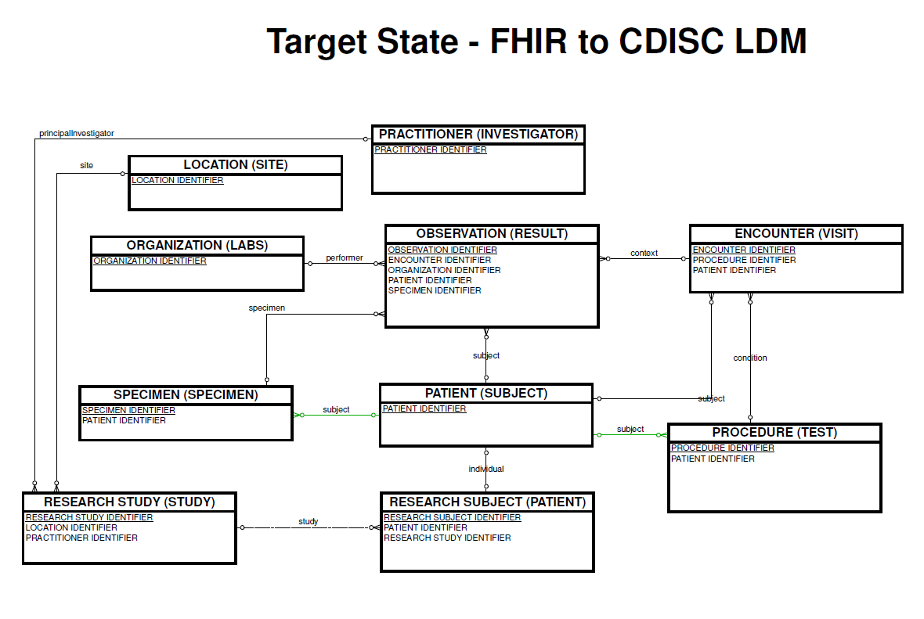
Target State FHIR to LDM Transformation

Slide 2
Target State FHIR to LDM Transformation
Maturity 3
Maturity 3
Maturity 5
Maturity 2
Maturity 3
Maturity 2
Maturity 5
Maturity 0
Maturity 3
Maturity 0

Slide 3
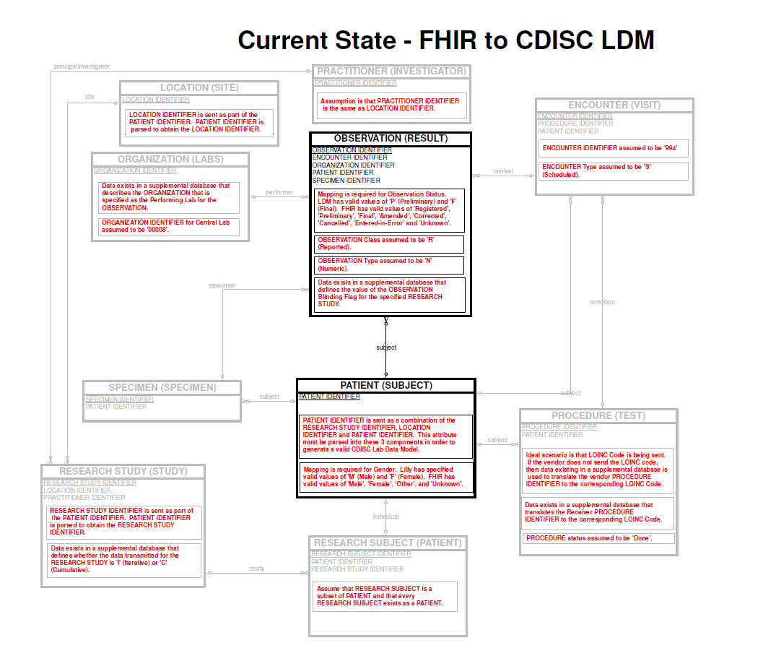
Current State FHIR to LDM Transformation

